Slide 1
DDSAnalytics Talent Management Solutions
Executive Briefing: Data-Driven Attrition Mitigation Strategy for Frito-Lay
Presented by: DDSAnalytics Senior Analytics Team
(Project Lead: David Sohn)
Date: October 2026
Notes:
Thank you for coming to our presentation. I’m proud to have completed the assessment to help with your company’s regrettable attrition and take proactive steps toward reduction for bottom line savings and maintained organizational efficiency.

Slide 2
Executive Summary
Turning Predictive Attrition Modeling into Bottom-Line Corporate Savings
The Mission
DDSAnalytics was retained by Frito-Lay to analyze workforce patterns, identify structural root causes of voluntary turnover, and build a localized predictive model capable of capturing flight risk prior to resignation.
The Findings
Financial exposure is heavily skewed by employee seniority. Standard statistical models fail because they prioritize overall accuracy over corporate fiscal reality and varying replacement liabilities.
The Solution
An algorithmic approach optimized for maximum financial return, pairing a proactive tracking framework with a low-cost, high-impact intervention program ($200 incentive per flagged staff).
The Bottom Line
By deploying targeted outreach packages based on model recommendations, Frito-Lay can capture $521,005 in net corporate cost savings across a standard 174-person employee slice.
DDSAnalytics Talent Management Solutions

Slide 3
The Core Vulnerability
Top 3 Drivers of Attrition at Frito-Lay Backed by Empirical Evidence
1. Overtime Status
Burnout proxy driving staff departure
Employees working overtime experience significantly higher attrition compared to standard schedules.
• Overtime Attrition Rate: 30.5%
• Standard Attrition Rate: 10.4%
Redesigning workflows or expanding capacity in high-overtime groups acts as a primary preventative shield.
2. Job Role & Context
Role pressures and alignment risk
Turnover is heavily concentrated within specific front-line and execution-heavy job positions.
• Sales Representatives: 39.8%
• Laboratory Technicians: 23.9%
Low entry-level job involvement or lack of clear skill progression demands targeted pathing overhauls.
3. Wage Compression
Financial tiering accelerates flight
Lower tier compensation tightly correlates with structural flight patterns within the first 1-3 years of tenure.
• Avg Monthly Income (Departed): $4,787
• Avg Monthly Income (Retained): $6,833
• Job Level 1 Attrition Rate: 27.6%
DDSAnalytics Talent Management Solutions
Slide 3

Slide 4
Shifting the Analytical Paradigm
Moving from Simple Statistical Accuracy to Pure Profit Maximization
Traditional Approach
(Maximizes General Accuracy)
• The Flaw of Default Cutoffs: Standard classifiers cut calculations off at a generic 50% probability threshold to balance mistakes evenly.
• Equal Penalties: Treats false alarms and missed resignations as having identical fiscal impacts.
• Outcome: Causes major financial blind spots, failing to protect high-level roles from steep recruitment penalties.
DDSAnalytics ROI Engine
(Maximizes Net Savings)
• Calibrated to Corporate Costs: Balances a tiny $200 prevention incentive against a severe $300,000 executive loss penalty.
• Optimized Thresholding: Searches dynamically to locate the precise position where corporate liabilities drop to their absolute minimum.
• Outcome: Casts a wider, hyper-profitable safety net protecting critical organizational revenue.
DDSAnalytics Talent Management Solutions
Slide 4

Slide 5
Model Validation Performance
Auditing the Risk Mitigation Matrix against the 174-Person Validation Group
 | Actual: Retained (No) | Actual: Departed (Yes)
Predicted: Retained (No) | 42 (True Negatives) | 1 (False Negative)
Predicted: Departed (Yes) | 104 (False Positives) | 27 (True Positives)
Operational Insights & Matrix Strategy
• Exceptional Risk Coverage: Caught 27 out of 28 total departures, achieving an exceptional 96.4% sensitivity metrics score.
• Strategic Safety Net: The model intentionally casts a wide net (104 false alarms). The minimal $200 prevention cost is vastly offset by securing critical personnel.
DDSAnalytics Talent Management Solutions
Slide 5

Slide 6
Hard Cost-Benefit Fiscal Ledger
Financial Returns Accounted with Tiered Role Disruption Modifiers (50% - 400%)
Unmitigated Liability
$2,320,572
Total financial cost if NO predictive modeling is used.
Exposes Frito-Lay to severe recruitment friction, loss of institutional knowledge, and standard operational placement fees across all 28 departing accounts.
Managed Strategy Cost
$1,799,567
Total running cost of the active program infrastructure.
Includes $26,200 in program intervention budgets spent plus remaining unrecovered role costs based on a conservative 40% retention program success rate.
NET SAVINGS YIELD
$521,005
Pure financial capital preserved by the enterprise.
Demonstrates absolute validation of the optimization loop. Mitigates critical human capital risks while delivering highly visible corporate returns.
DDSAnalytics Talent Management Solutions
Slide 6

Slide 7
Enterprise Deployment Roadmap
Immediate Operational Steps Towards Organizational Rollout
Phase 1
Core System Ingestion
• Connect active HR databases directly into the analytical processing environment.
• Standardize active tracking attributes across all geographical divisions to enable rolling calculations.
Phase 2
Targeted Pilot Launch
• Deploy immediate alert workflows to localized manager classes within high-risk teams.
• Prioritize execution tracking specifically to Sales structures and critical Laboratory sectors.
Phase 3
Live Monitoring Suite
• Automate corporate metric scorecards tracking dynamic performance levels over time.
• Provide ongoing visual reporting audits updating continuous programmatic net savings profiles directly to executive leadership.
DDSAnalytics Talent Management Solutions
Slide 7

Slide 8
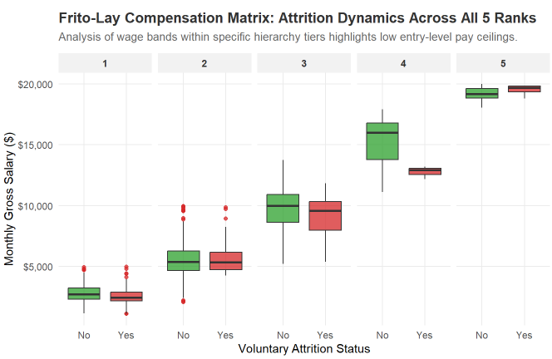
Data Visualization
DDSAnalytics Talent Management Solutions
Slide 8

Slide 9
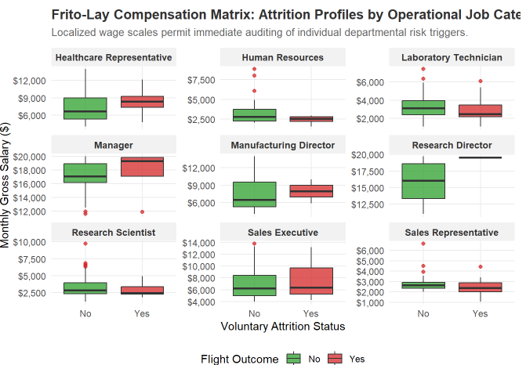
Data Visualization
DDSAnalytics Talent Management Solutions
Slide 9

Slide 10
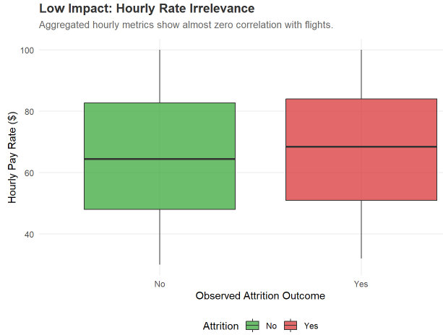
Data Visualization
DDSAnalytics Talent Management Solutions
Slide 10

Slide 11
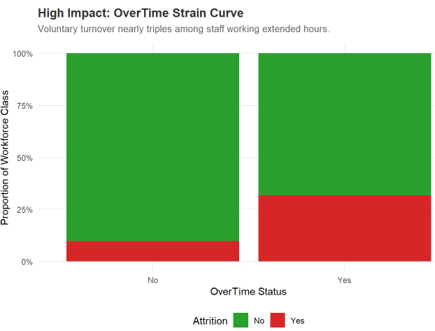
Data Visualization
DDSAnalytics Talent Management Solutions
Slide 11

Slide 12
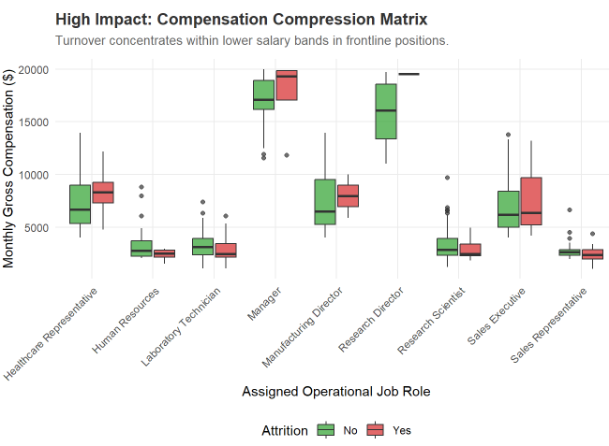
Data Visualization
DDSAnalytics Talent Management Solutions
Slide 12

Slide 13
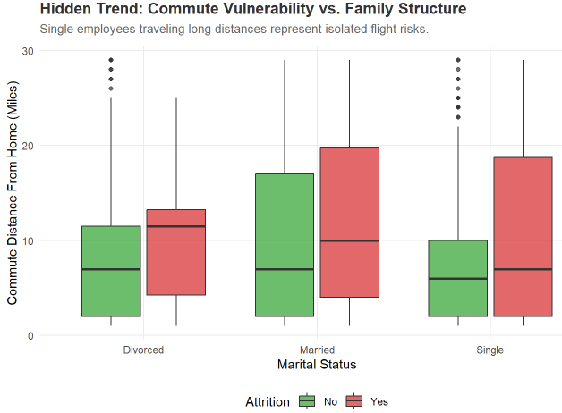
Data Visualization
DDSAnalytics Talent Management Solutions
Slide 13

Slide 14
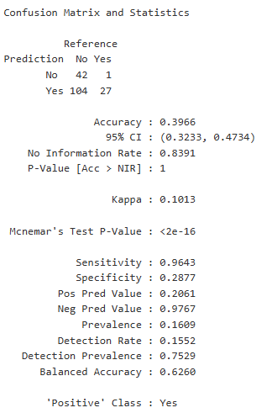
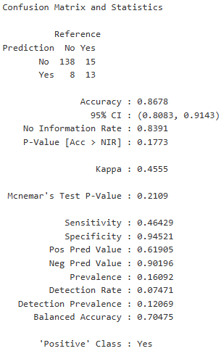
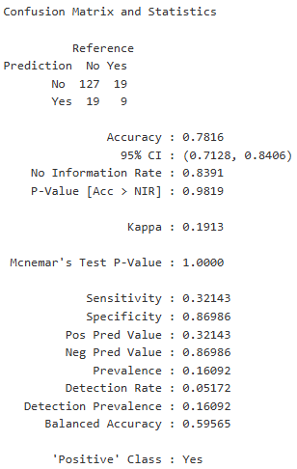
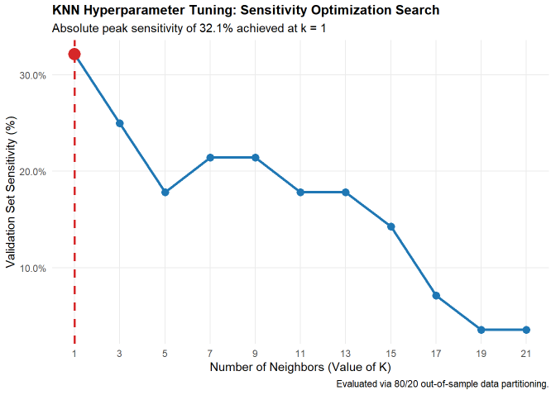
Model Comparisons
Generalized Linear Model (GLM)
(https://www.geeksforgeeks.org/r-language/generalized-linear-models-using-r/)
• Accuracy 39.66%
• Sensitivity 96.43%
• Specificity 28.77%
Naïve Baynes
• Accuracy 86.78%
• Sensitivity 46.43%
• Specificity 94.52%
k-NN
• Accuracy 78.16%
• Sensitivity 32.14%
• Specificity 86.99%
DDSAnalytics Talent Management Solutions
Slide 14

Slide 15
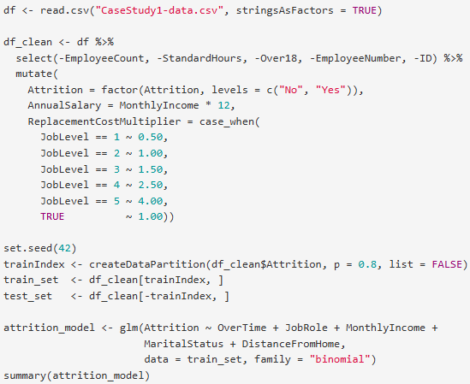
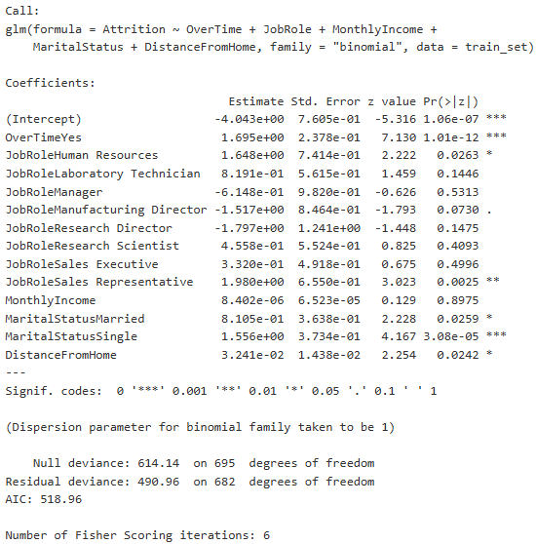
GLM Results
• Any factor with a P value less than .05 should be investigated as a potential identifier for attrition.
Behind the Green Curtain
A look at the R Studio Mark Down File
Code Description
• Read the data (of 870 employees, 140 departed, 730 remained)
• Clean the data, including setting job levels to identify cost to company for regrettable attrition
• Set seed to make model results replicable
• Divide data into 80-20 train/test set
• Setup model and inspect
• Use of Generalized Linear Model (GLM): https://www.geeksforgeeks.org/r-language/generalized-linear-models-using-r/
Model Fit
• An explanation of 123.18 points over 13 degrees of freedom shows a highly significant reduction in error.

Slide 16
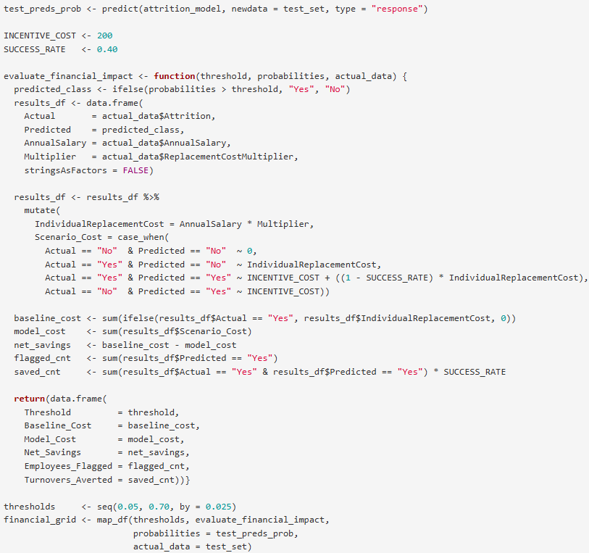
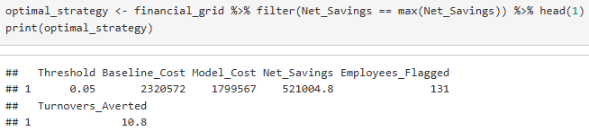
Behind the Green Curtain
A look at the R Studio Mark Down File
Code Description
• Run financial evaluation for the test data to consider baseline cost, model cost, and net savings for all test employees
• Set threshold to 70% which resulted in (131 employees flagged) with a 95% probability of correctly identifying flight risks and consider baseline vs model cost to maximize financial returns.
• Check optimal strategy results

Slide 17
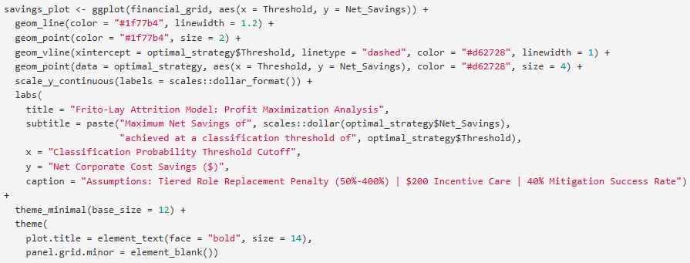
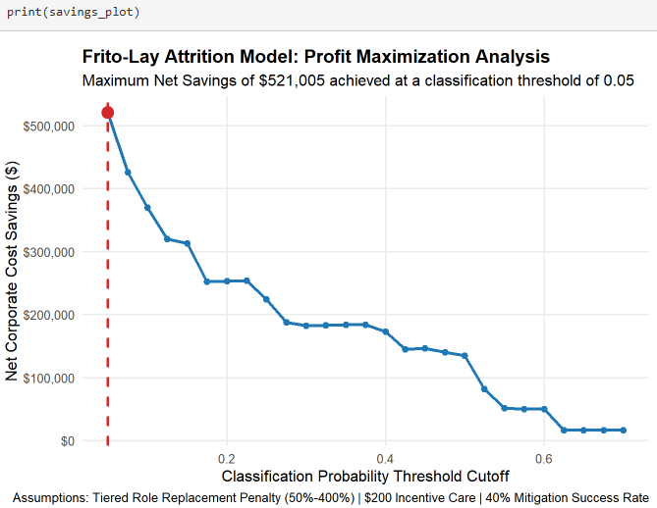
Behind the Green Curtain
A look at the R Studio Mark Down File
Code Description
• Make ROI Plot for Plot for alpha considerations (95% probability) and a 40% mitigation success rate (40% of those that were identified as flight risks stayed due to preventative action ($200 incentive care)).

Slide 18
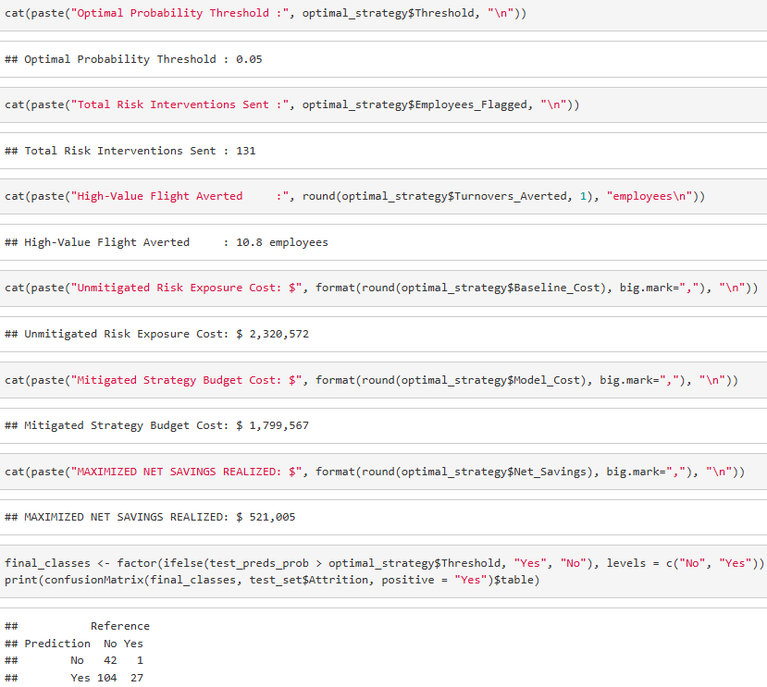
Behind the Green Curtain
A look at the R Studio Mark Down File
Code Description
• Final verification of model results to produce slide deck including employees that stayed, risk exposure cost (calculated by annual salaries and replacement cost), mitigation strategy cost, savings, and resultant model truth table.

Slide 19
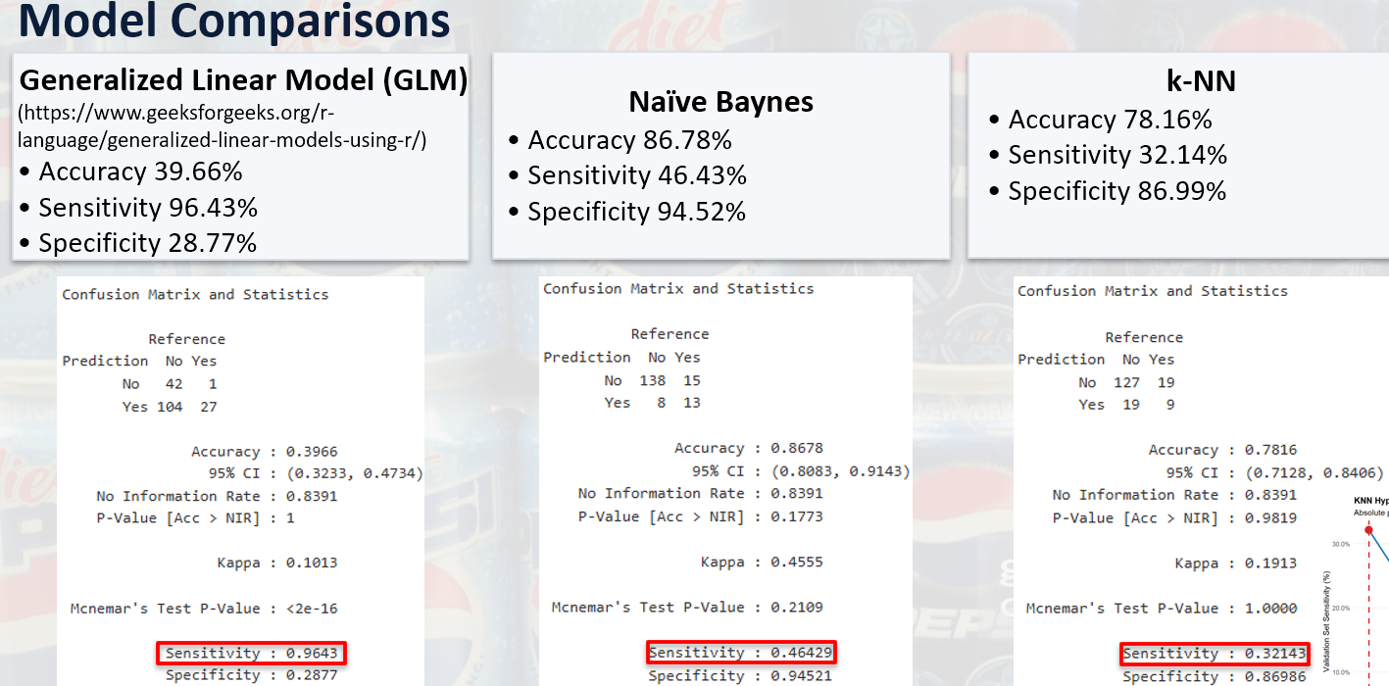
Competition Portion
60% Sensitivity and 60% Specificity Challenge
Model Selection
• As noted in a previous slide, all previously evaluated models (GLM, Naïve Baynes, and k-NN) failed to achieve 60% for both sensitivity and specificity.
• After searching some RStudio model resources, Random Forest (RF) seemed like a good model for this use case.
https://www.geeksforgeeks.org/r-language/random-forest-approach-in-r-programming/

Slide 20
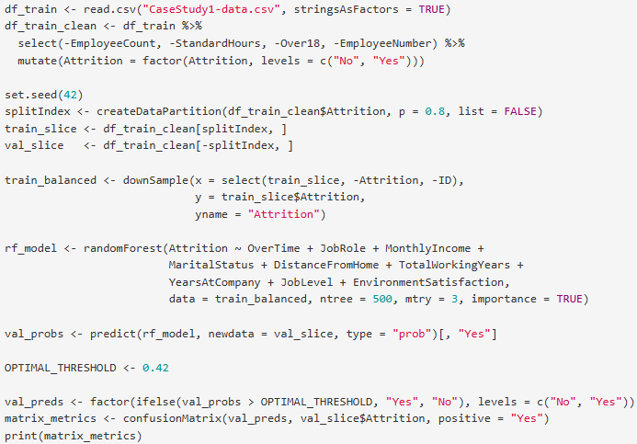
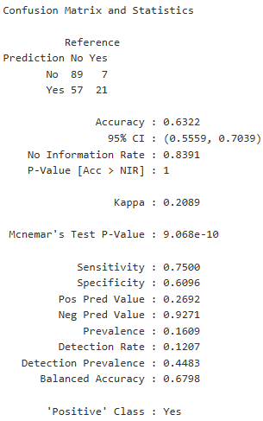
Behind the Green Curtain
Random Forest (RF) Code for 0.42 Threshold
Code Description
• Read data file
• Cleaned data
• Set seed
• Split data 80/20 for training/test
• Set up Random Forest model
• Check val_ probs
• Set up Random Forest model
• Used classification threshold of 0.42 to set final val_preds
• Checked confusion matrix to evaluate model performance

Slide 21
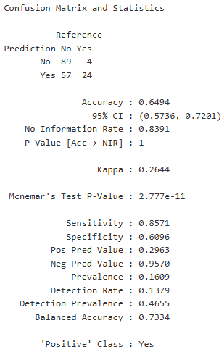
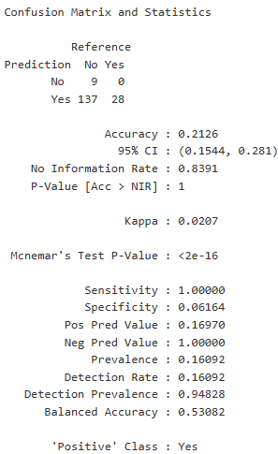
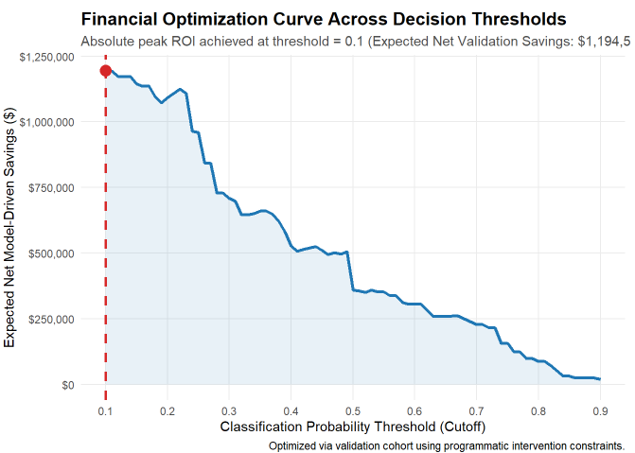
Model Comparisons
RF1 w/ 0.42 Threshold
• Accuracy 63.22% (Max 70.39%)
• Sensitivity 75.00%
• Specificity 60.96%
• Sen+Spec 135.96%
RF2 w/ 0.40 Threshold
• Accuracy 64.94% (Max 72.01%)
• Sensitivity 85.71%
• Specificity 60.96%
• Sen+Spec 136.67%
RF3 w/ 0.1 Threshold
• Accuracy 21.26% (Max 28.1%)
• Sensitivity 100%
• Specificity 6.16%
• Sen+Spec 106.16%

Slide 22
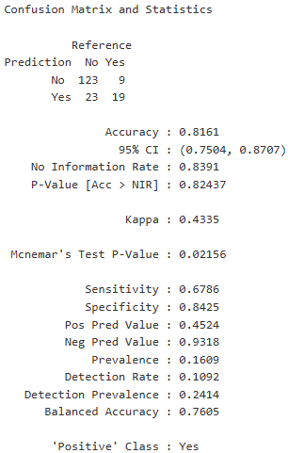
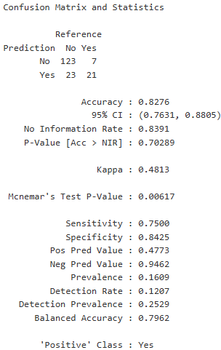
Model Comparisons
NB w/ 0.50 Threshold
• Accuracy 86.78%
• Sensitivity 46.43%
• Specificity 94.52%
• Sen+Spec 135.96%
NB2 w/ 0.30 Threshold
• Accuracy 81.61%
• Sensitivity 67.86%
• Specificity 84.25%
• Sen+Spec 152.03%
NB3 w/ 0.2918321 Threshold
• Accuracy 82.76%
• Sensitivity 75.00%
• Specificity 84.25%
• Sen+Spec 159.25%

Slide 23
Where’s the Money At?
Comparison of Model Savings
Categories | RF1 (0.42) | RF2 (0.40) | RF3 (0.10)
Accuracy | 63.22% | 64.94% | 21.26%
Sensitivity | 75.00% | 85.71% | 100%
Specificity | 60.96% | 60.96% | 6.16%
Employees | 300 | 300 | 300
Flight Risk Employees | 142 | 156 | 286
Targeted Flights Saved | 56.8 | 62.4 | 19.4
Total Risk Exposure | $10,439,148 | $14,191,428 | $45,190,686
Programmatic Outreach Spend | $28,400 | $31,200 | $57,200
Gross Attrition Saved | $4,175,659 | $5,676,571 | $3,067,489
Net Model-Driven Savings | $4,147,259 | $5,645,371 | $3,010,289
Model Savings
• RF2 (0.40 threshold) seems to have the best overall performance as noted in the earlier slide.
• RF2 also has the best mix of accuracy and savings (64.94% and $5,645,371, respectively).
• While RF3 seems to have identified 100% of employees likely to leave, it suffers from a very low accuracy, which is corrected in the Targeted Flights Saved.

